Slide 1
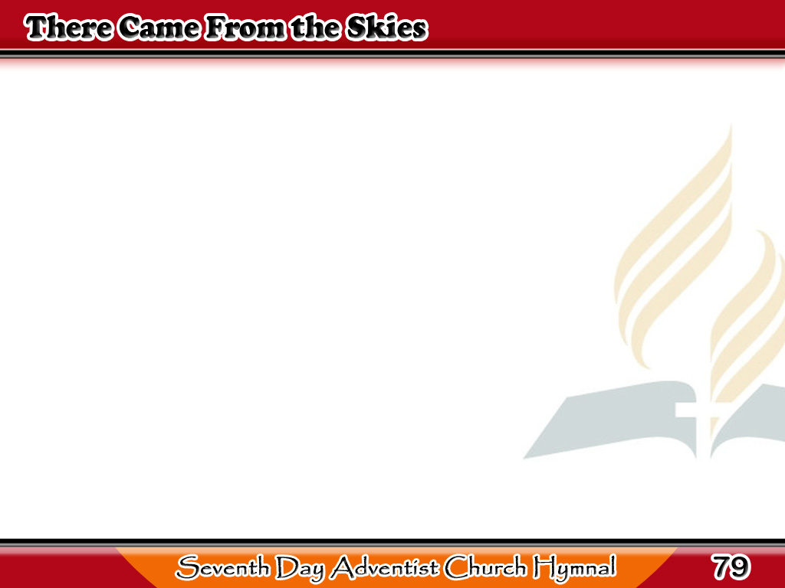
Ang Panginoo’y Nanaog sa Lupa
There came from the skies
in the days long ago
The Lord with a message
of love;
1/4

Slide 2
Ang Panginoo’y Nanaog sa Lupa
The world knew Him not;
He was treated with scorn
This wonderful gift
from above.
1/4

Slide 3
Ang Panginoo’y Nanaog sa Lupa
-Refrain-
They crowned Him with thorns,
He was beaten with stripes
He was smitten and nailed
to the tree,
1/4

Slide 4
Ang Panginoo’y Nanaog sa Lupa
-Refrain-
But the pain in His heart
was the hardest to bear,
The heart that was
broken for me.
1/4

Slide 5
Ang Panginoo’y Nanaog sa Lupa
He came to His own to
the ones that He loved;
The sheep that had
wandered astray;
2/4

Slide 6
Ang Panginoo’y Nanaog sa Lupa
They heard not His voice;
but the friend of mankind
Was hated and driven away.
2/4

Slide 7
Ang Panginoo’y Nanaog sa Lupa
-Refrain-
They crowned Him with thorns,
He was beaten with stripes
He was smitten and nailed
to the tree,
2/4

Slide 8
Ang Panginoo’y Nanaog sa Lupa
-Refrain-
But the pain in His heart
was the hardest to bear,
The heart that was
broken for me.
2/4

Slide 9
Ang Panginoo’y Nanaog sa Lupa
The birds have their nests,
and the foxes have holes,
But He had no place
for His head;
3/4

Slide 10
Ang Panginoo’y Nanaog sa Lupa
A pallet of stone on the
cold mountain side,
Was all that He had
for His bed.
3/4

Slide 11
Ang Panginoo’y Nanaog sa Lupa
-Refrain-
They crowned Him with thorns,
He was beaten with stripes
He was smitten and nailed
to the tree,
3/4

Slide 12
Ang Panginoo’y Nanaog sa Lupa
-Refrain-
But the pain in His Heart
was the hardest to bear,
The heart that was broken
for me.
3/4

Slide 13
Ang Panginoo’y Nanaog sa Lupa
I cannot reject such
a Saviour as He;
Dishonor and wound
Him again;
4/4

Slide 14
Ang Panginoo’y Nanaog sa Lupa
I’ll go to His feet
and repent of my sin,
Be willing to suffer
the pain.
4/4

Slide 15
Ang Panginoo’y Nanaog sa Lupa
-Refrain-
I’ll take up my cross,
I will walk by His side
For the pathway of duty I see,
(Yes, I see)
4/4

Slide 16
Ang Panginoo’y Nanaog sa Lupa
-Refrain-
I will follow my Lord
and abide in His heart,
The heart that was broken
for me.
4/4

